Slide 1

IoT Module ESP32 with Blynk Platform
Prepared by: Muhammad Shahkhir Bin Mozamir

Slide 2
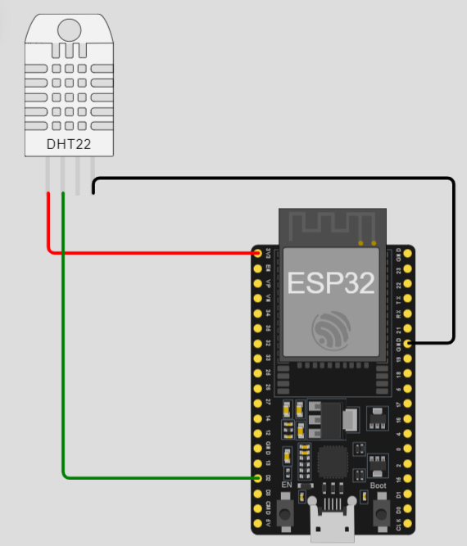
Module 2: Control LED using Blyink Platform
Set up the DHT22 on ESP32 USING https://wokwi.com/projects/new/esp32
Ground Sensor to Gnd ESP
SDA Sensor to pin esp:D2

Slide 3
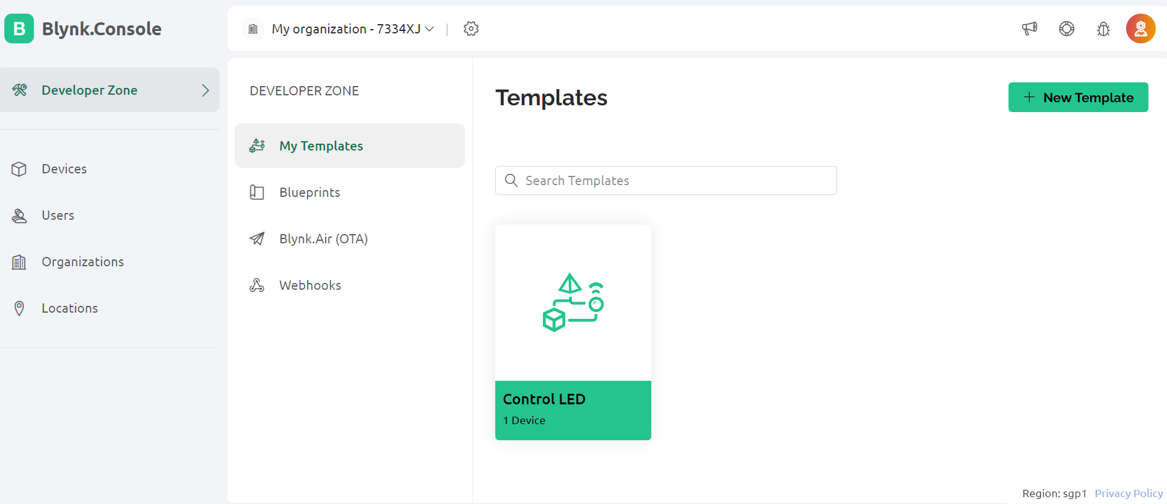
Click New Template

Slide 4
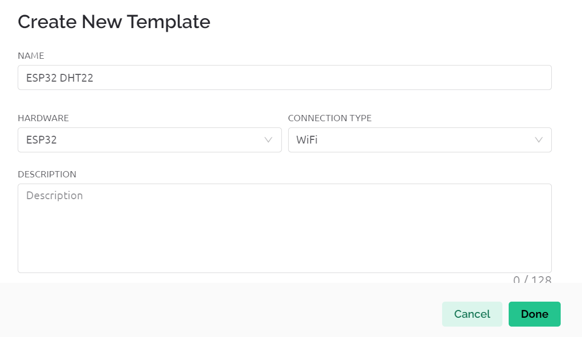
Name the template as in Figure:

Slide 5
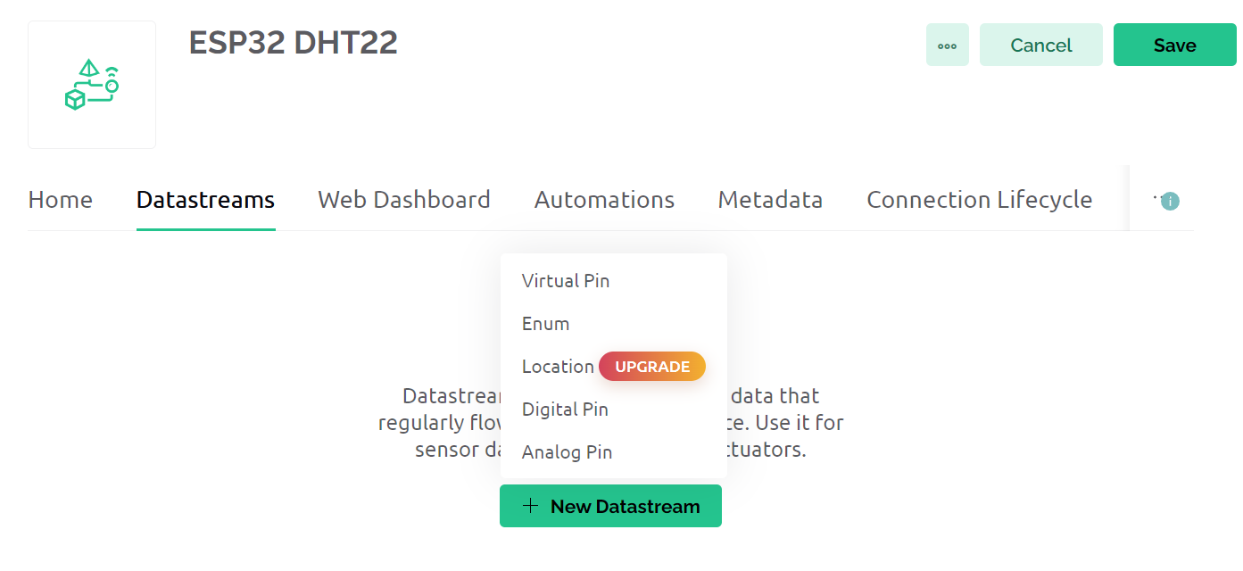
Datastreams tab, click edit and new Datastreams. Then click Virtual Pin

Slide 6
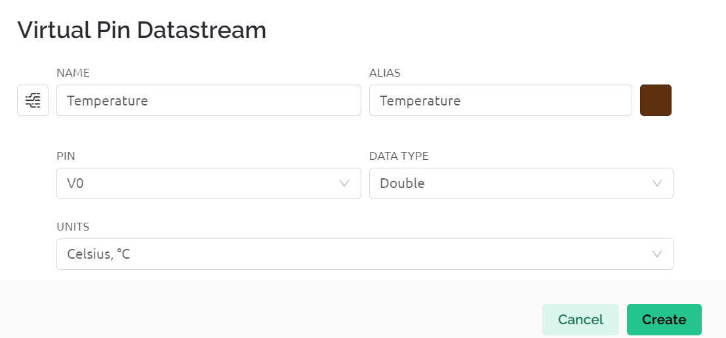
Setup the parameter:

Slide 7
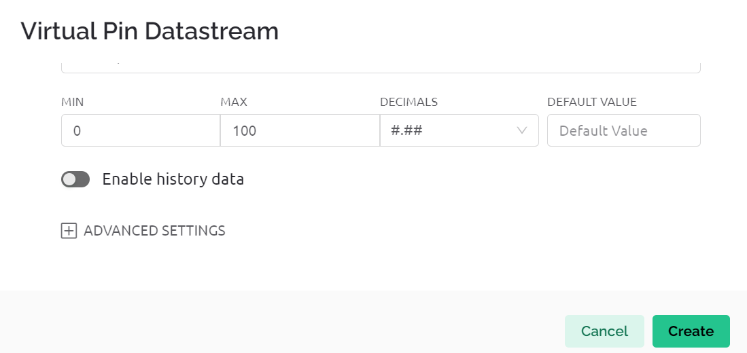
Setup parameter:

Slide 8
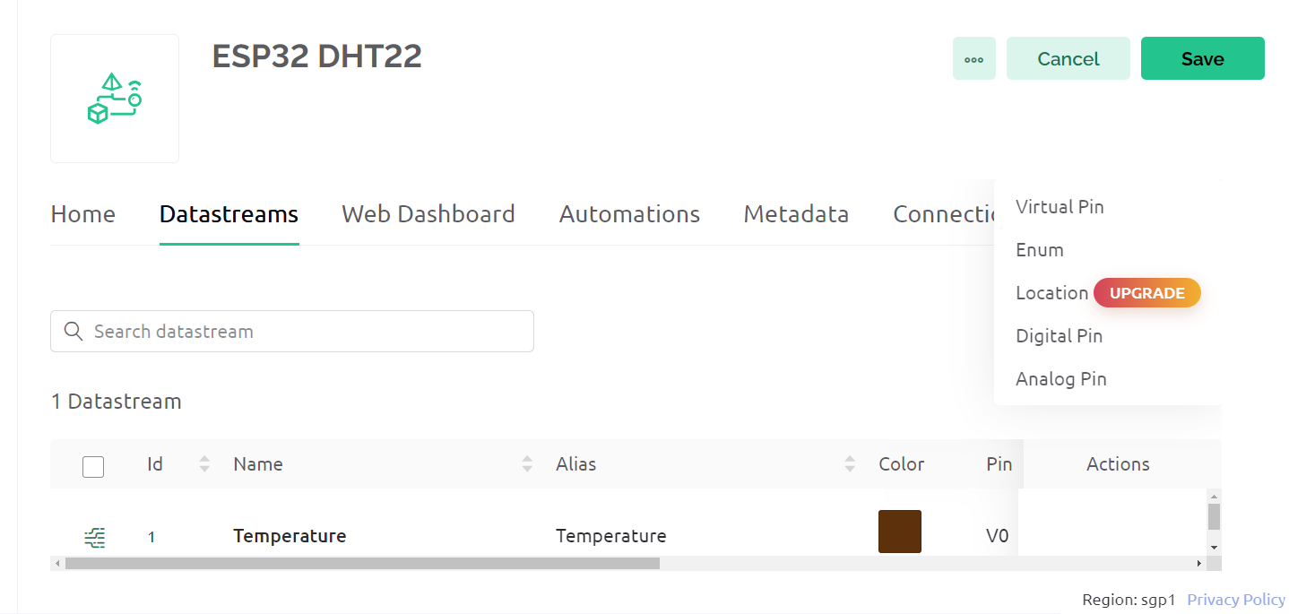
Add another datasteams:

Slide 9
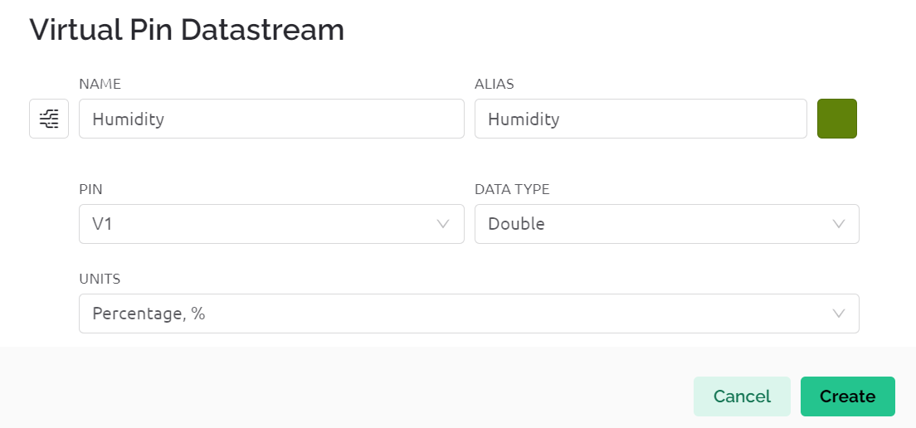
Setting parameter:

Slide 10
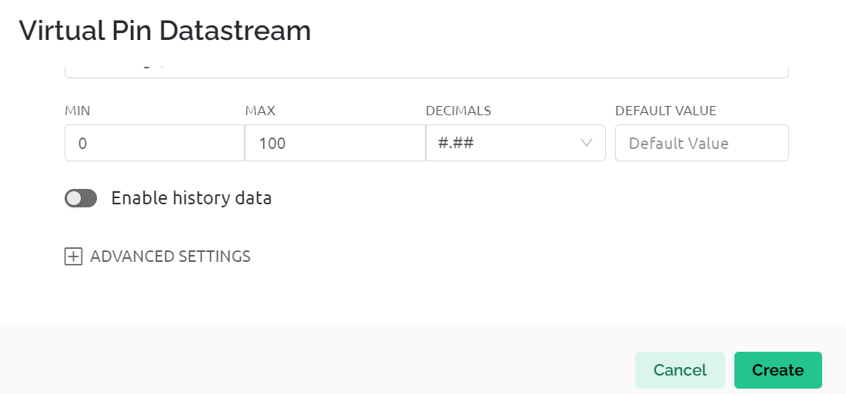
Setting parameter:

Slide 11
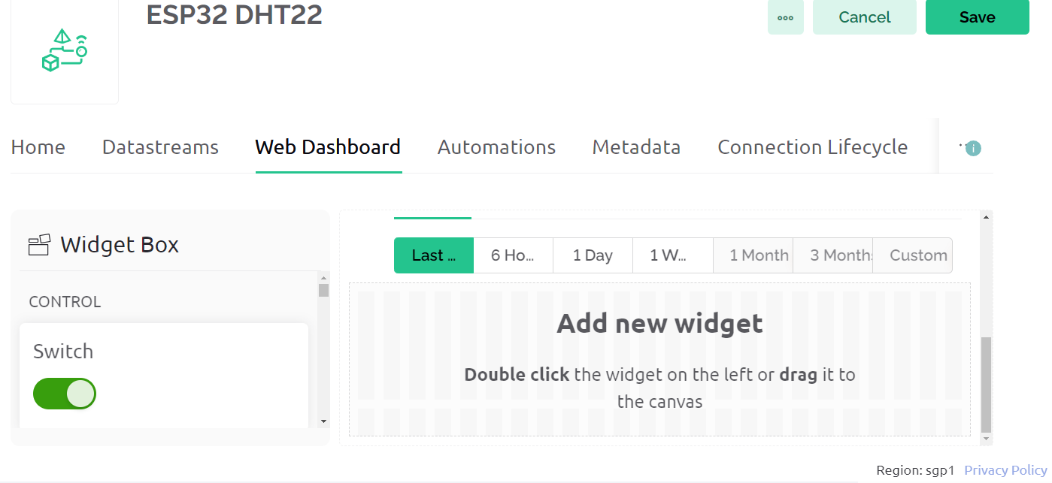
Click Web Dashboard

Slide 12
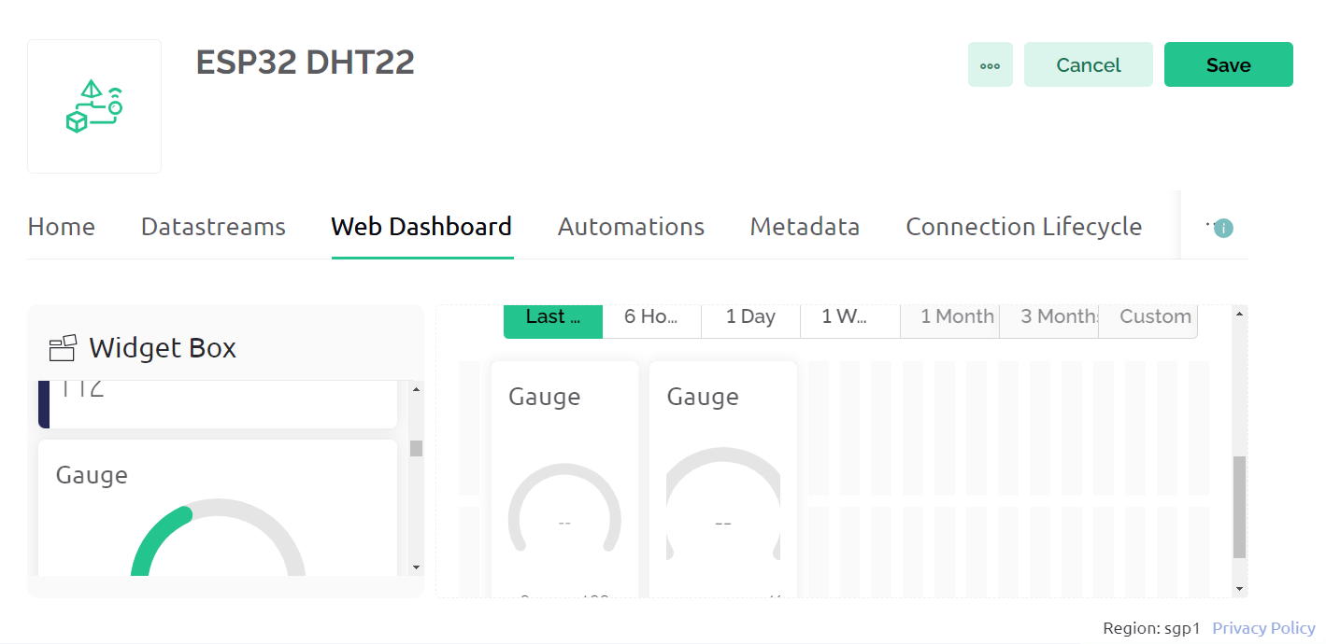
Drag Gauge to the dashboard:

Slide 13
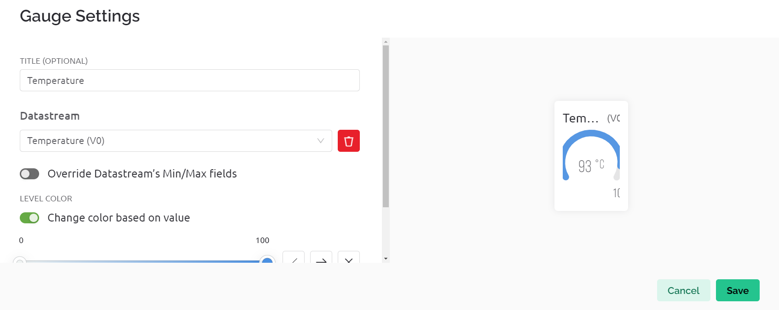
Click setting at Gauge and follow Figure:

Slide 14
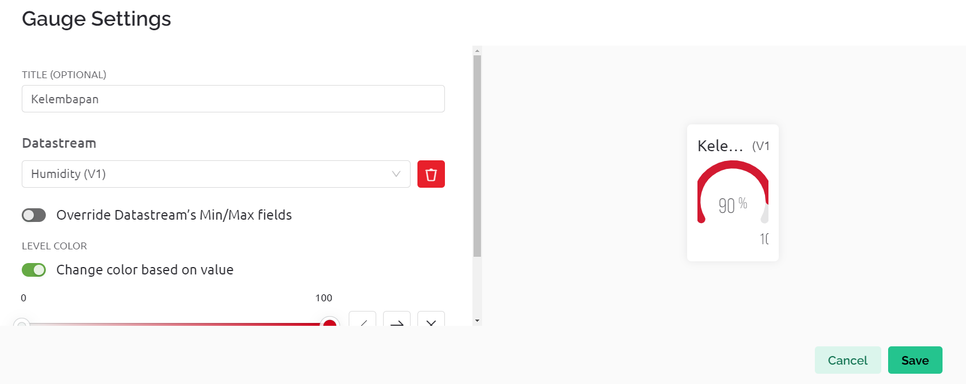
Setting 2nd Gauge :

Slide 15
Click save data

Slide 16
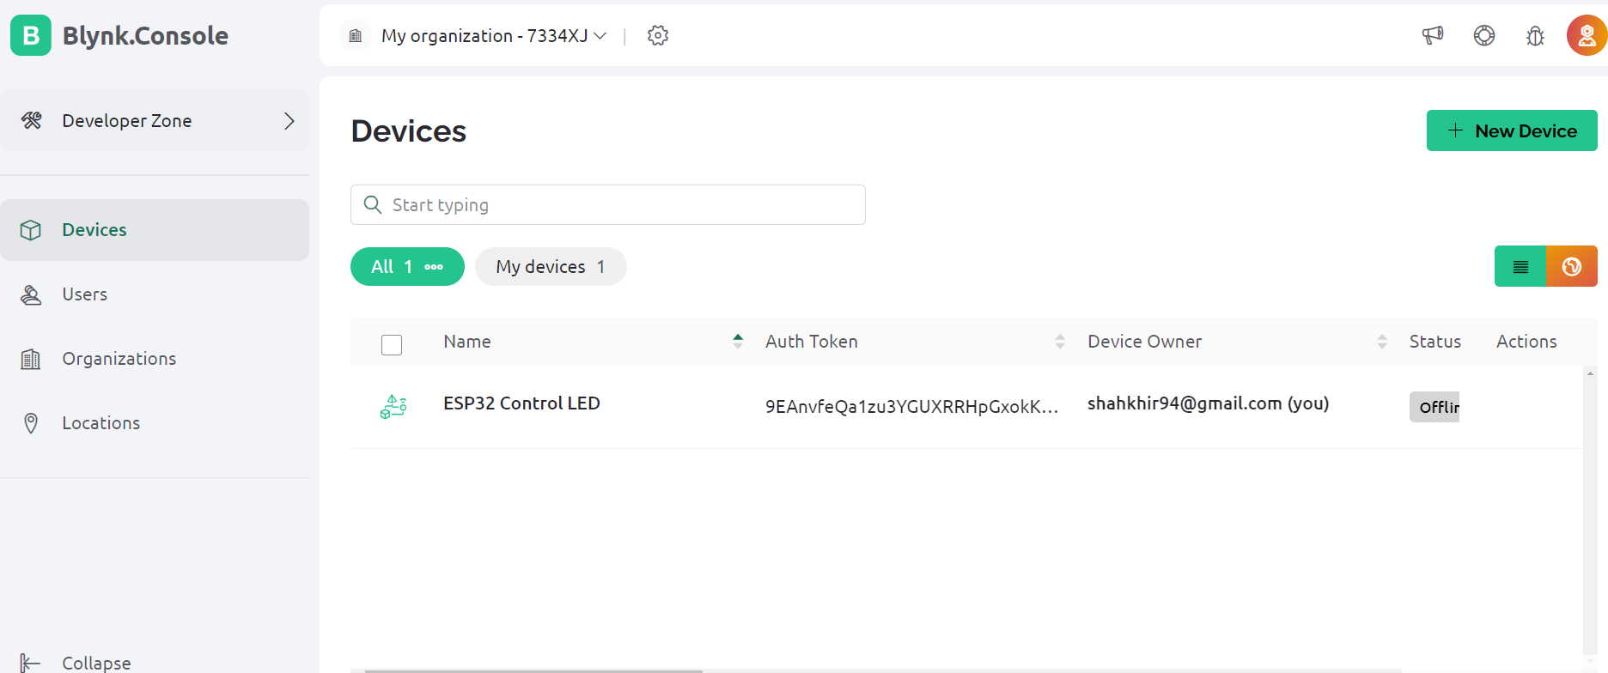
Click Device and New Device:

Slide 17
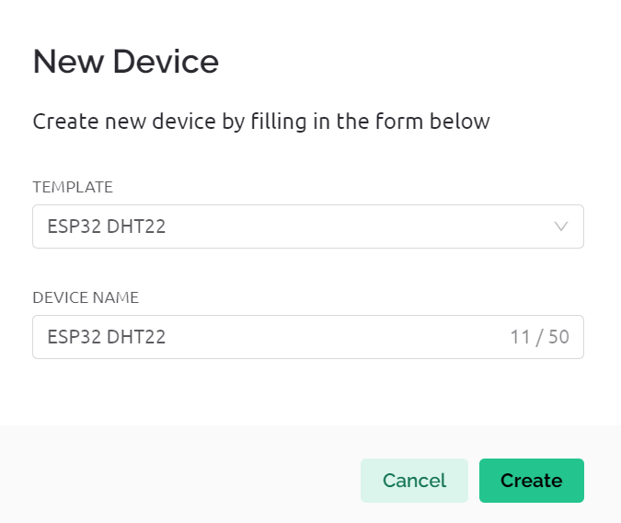
Create new device:

Slide 18
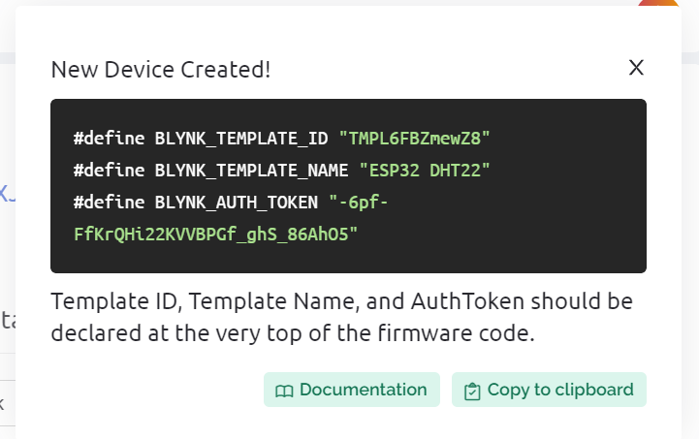
Copy the library #

Slide 19
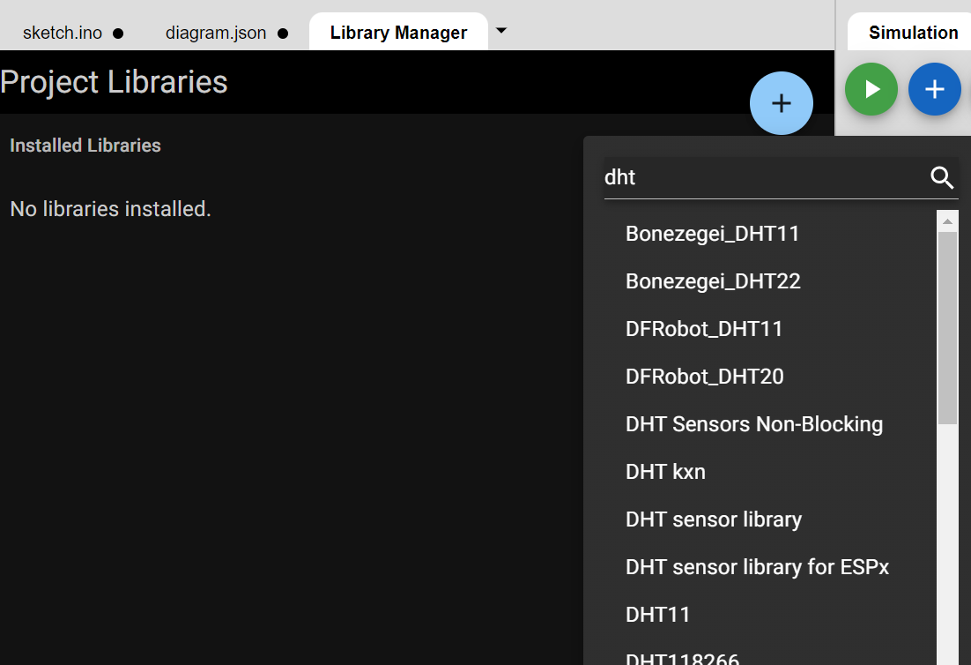
Click Library Manager and install library:

Slide 20
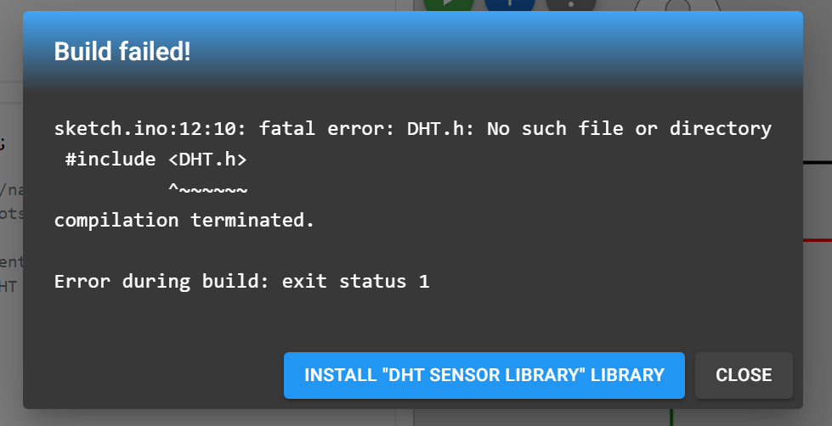
Install DHT library

Slide 21
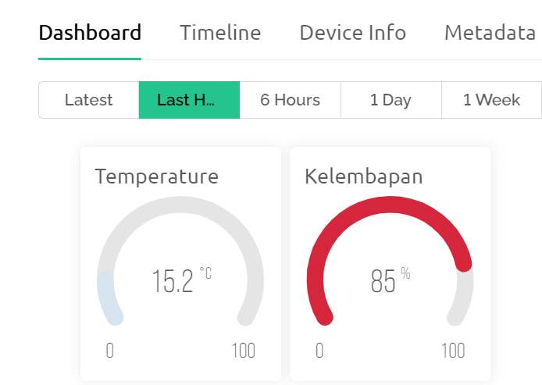
Result

